Slide 1
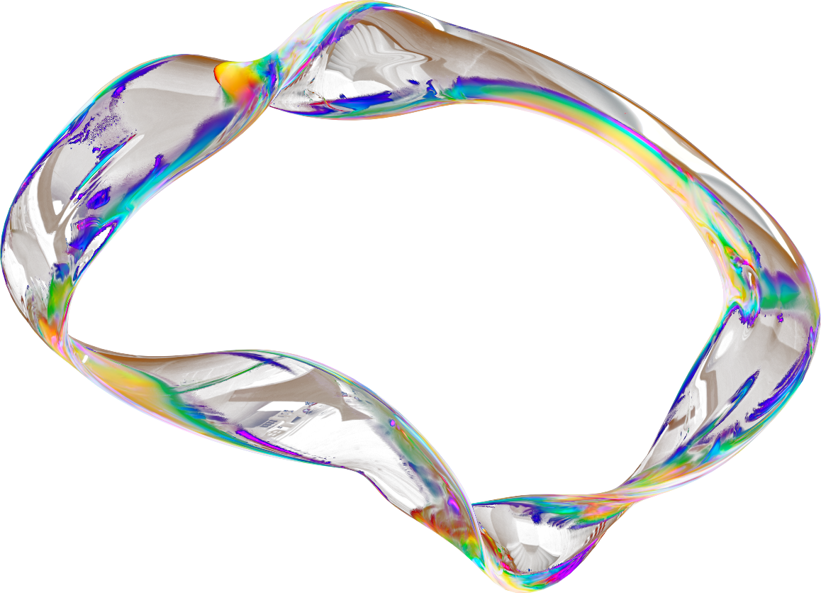
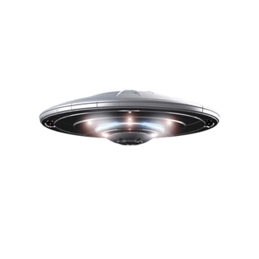
GEOSPATIAL &
TEMPORAL ANALYSIS OF NUFORC UFO SIGHTING DATA
PROJECT MENTOR:
DR. ARNAB CHAKRABORTY
TEAM MEMBERS:
Avinaba Roy | Chetona Roy | Devdeep Hazra | Diya Hazra | Somnath Chakraborty

Slide 2

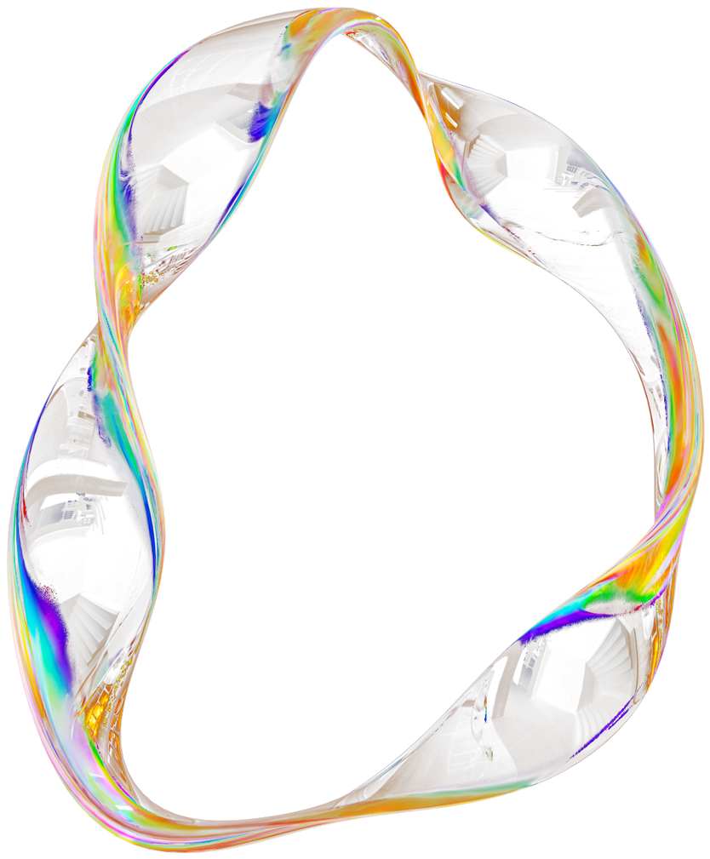
TODAY'S AGENDA
1
Project Objective & Scope
5
Models Used
2
Data Description
6
Accuracy Comparison
3
Methodology
7
Useful Application
4
Data Preprocessing
8
Conclusion

Slide 3
PROJECT OBJECTIVE & SCOPE
Given : A NUFORC UFO sightings dataset containing details like date, time, location, and textual descriptions.
Goal : To analyze UFO sightings using geospatial, temporal, and text-mining techniques in order to identify patterns, hotspots, and themes.
Finally : Apply clustering, keyword extraction, and visualization methods to generate meaningful insights and compare results across regions and time periods.
It is a useful project as geospatial and temporal analysis helps to visualize trends and hotspots of UFO sightings worldwide.
Machine learning and text analysis allow us to uncover hidden patterns in reports (e.g., common shapes, locations, or times).
The results may not perfectly reflect real-world UFO activity since the data is self-reported and subjective, but still provide valuable cultural and statistical insights.
OBJECTIVE :
SCOPE :

Slide 4
COLUMNS
ATTRIBUTE NAME
TYPE
DESCRIPTION
TARGET ATTRIBUTE
Date Time
Date Time
Non-categorical
Date and time when the sighting was reported.
No
City
City
Categorical
City where the sighting occurred.
No
State
State
Categorical
State (US) where the sighting occurred.
No
Country
Country
Categorical
Country where the sighting occurred.
No
Shape
Shape
Categorical
Shape of the object sighted (e.g., circle, light, triangle, etc.).
No
Duration(in s)
Duration(in s)
Non-categorical
Duration of the sighting in seconds.
No
DATA
DESCRIPTION
Duration(in hours/min)
Duration(in hours/min)
Non-categorical
Duration of the sighting in hours or minutes
No
Comments
Comments
Categorical
Written description or notes about the sighting.
No
Date Posted
Date Posted
Non-categorical
Date when the sighting report was posted online.
No
The description of the data with type and description of each Attribute is given/shown in the table.
Non-categorical
Latitude coordinate of the sighting location.
Latitude
Latitude
No
Longitude
Longitude
Non-categorical
Longitude coordinate of the sighting location.
No

Slide 5
METHODOLGY
Data Fetch
Data Pre-processing
Training Models
Implementing Trained Models on Test Dataset
Data Study
Selecting Principal Attributes
Testing Models
End

Slide 6
DATA PRE-PROCESSING
📌 Dataset Issues
Incomplete rows
Mixed date formats
Strange symbols in comments
⚙️ Steps
Loaded with Pandas (on_bad_lines='skip')
Cleaned comments (HTML, special chars, lowercase)
Handled missing values
Unified date & time formats
⚠️ Challenges
Large file size slowed operations
Inconsistent time formats caused parsing errors
✅ Outcome
Structured dataset, ready for analysis

Slide 7
MODELS USED
KMEANS (CLUSTERING)
TF-IDF VECTORIZER (TEXT ANALYSIS)
Groups UFO sightings into k geographic clusters.
Used to find hotspot regions.
DBSCAN (CLUSTERING)
Extracts top keywords from UFO comments.
Identifies important terms (e.g., "light", "alien").
Density-based clustering to detect dense UFO sighting areas and outliers.
Useful for irregular cluster shapes.
RANDOM FOREST CLASSIFIER
SHAPE PREDICTION
Predicts UFO shape (circle, disk, triangle, etc.).
Input features: latitude, longitude, year, month, hour, duration, night_flag, shape_complexity.
Accuracy is calculated on test split.
Trains a RandomForestClassifier to predict shape.
Uses handpicked features.
Encodes target variable and shows model accuracy.

Slide 8
FEATURE-ENGINEERING
Objective
My role was to create new, informative features from the existing raw data to improve the performance of our subsequent analyses and models.
Features Created
Seasonal Data: We categorized sightings into seasons (Winter, Summer, etc.) based on the month, helping to analyze seasonal patterns.
Night Flag: A binary flag (1 or 0) was created to identify sightings that occurred between 8 PM and 5 AM, as a significant number of reports happen at night.
Shape Complexity Score: We assigned a score to each UFO shape, distinguishing between simple shapes (e.g., circle, light) and complex ones (e.g., triangle, formation).
Distance to Area 51: Using the Haversine formula, we calculated the distance of each sighting from Area 51, a known hotspot.
Eerie Factor: This was a custom score based on the presence of specific keywords (alien, abduction) in the comments combined with a long duration, to highlight particularly unusual encounters.
Challenges
Incomplete Data: Some records were missing latitude and longitude data, which made calculating the distance from Area 51 impossible for those rows.
Subjectivity: Defining and scoring shape complexity required making subjective decisions.
Time Zones: We faced challenges in standardizing the night flag due to inconsistencies and a lack of specific time zone information in the raw data.

Slide 9
K-MEANS & DBSCAN
Methodology
K-Means: We used this method to divide the data into a fixed number of clusters. This was effective for getting a clear picture of general hotspot areas.
DBSCAN: This technique was used to automatically detect dense clusters and identify individual outliers, giving us more granular insight into sighting patterns.
Visualization & Findings
We successfully visualized the clustered hotspots using Folium maps and heatmaps.
The results clearly showed high concentrations of UFO sightings in key areas such as California, Arizona, and the vicinity of Area 51.
Challenges
K-Means: A key challenge was determining the optimal number of clusters, or 'k', for the best results.
DBSCAN: We had to carefully tune parameters (eps and min_samples) to ensure meaningful cluster formation.
Performance: The sheer volume of data points (lakhs) slowed down our dashboard, which we mitigated by using data sampling.

Slide 10
TF-IDF
Objective
The goal was to extract meaningful patterns from the text comments in each UFO sighting report using TF-IDF (Term Frequency-Inverse Document Frequency).
Methodology
Preprocessing: The raw text comments were cleaned by converting them to lowercase and removing common "stop words."
TF-IDF Vectorization: We applied this technique to identify and score the most important and unique words or phrases.
Analysis: We examined both unigrams (single words) and bigrams (word pairs) to capture descriptive language.
Key Findings
The analysis revealed common phrases used by witnesses, such as:
'bright light'
'disk shaped'
'fast moving'
'strange sound'
Challenges
Data Quality: A significant number of comments were either too short or completely empty.
Spelling Errors: Typos and misspellings in the free-text comments reduced the accuracy of our analysis.
Filtering: Despite preprocessing, very common but unhelpful words like "looked" or "thing" were still present in the results.

Slide 11
SHAPE PREDICTION
Objective
The goal was to build a machine learning model to predict the shape of a UFO based on the sighting's characteristics.
Methodology
Model: We used a Random Forest Classifier for this task.
Input Features: The model was trained on a variety of features, including:
latitude & longitude
year, month, hour
duration
night flag (is it dark outside?)
shape complexity
Prediction: The model was able to predict common shapes like 'circle', 'light', 'disk', and 'triangle'. We achieved good accuracy for these frequent shapes.
Challenges
Dataset Imbalance: The most significant challenge was that the dataset was heavily skewed. A large majority of reports simply described a 'light', making it difficult to predict other shapes.
Insufficient Data: Rare shapes like 'chevron' or 'cigar' had too few samples, which made accurate prediction nearly impossible.
Overfitting: We had to carefully tune the model to prevent it from simply memorizing the training data instead of learning general patterns.

Slide 12
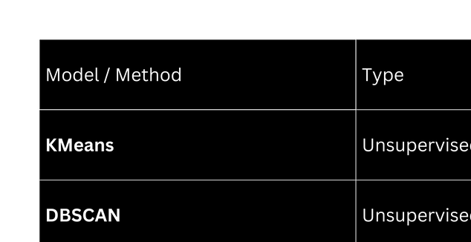
ACCURACY
Summary:
Only the RandomForest classifier has measurable accuracy.
The other models (KMeans, DBSCAN, TF-IDF) are exploratory/unsupervised, so accuracy comparison doesn’t apply.

Slide 13
USEFUL APPLICATIONS
Identification of geographical hotspots where UFO sightings are frequently reported.
Extraction of key terms from sighting descriptions to assist researchers in pattern discovery.
Prediction of UFO shapes using classification models for improved categorization.
Development of interactive dashboards for public engagement and real-time monitoring.
Adaptation of the same framework to other domains such as crime reports, disaster response, or wildlife movement tracking.

Slide 14
CONCLUSION
Key Learnings
Hands-on practice with messy data, preprocessing, clustering, NLP, and ML
Built a working interactive dashboard
Learned to tackle imbalanced data, tech integration, and teamwork
Future Scope
Extend with Deep Learning models (LSTMs, BERT) for text analysis
Connect with live UFO reporting systems for real-time insights
Takeaway
Improved both technical knowledge and team collaboration skills

Slide 15

NUFORC UFO Explorer
THANK YOU
for your time and attention
Present by Team no. 9

